Slide 1



Brand Of Me Lorraine Rew - Industry Talent Manager CodeClan Careers Team
www.codeclan.com

Slide 2
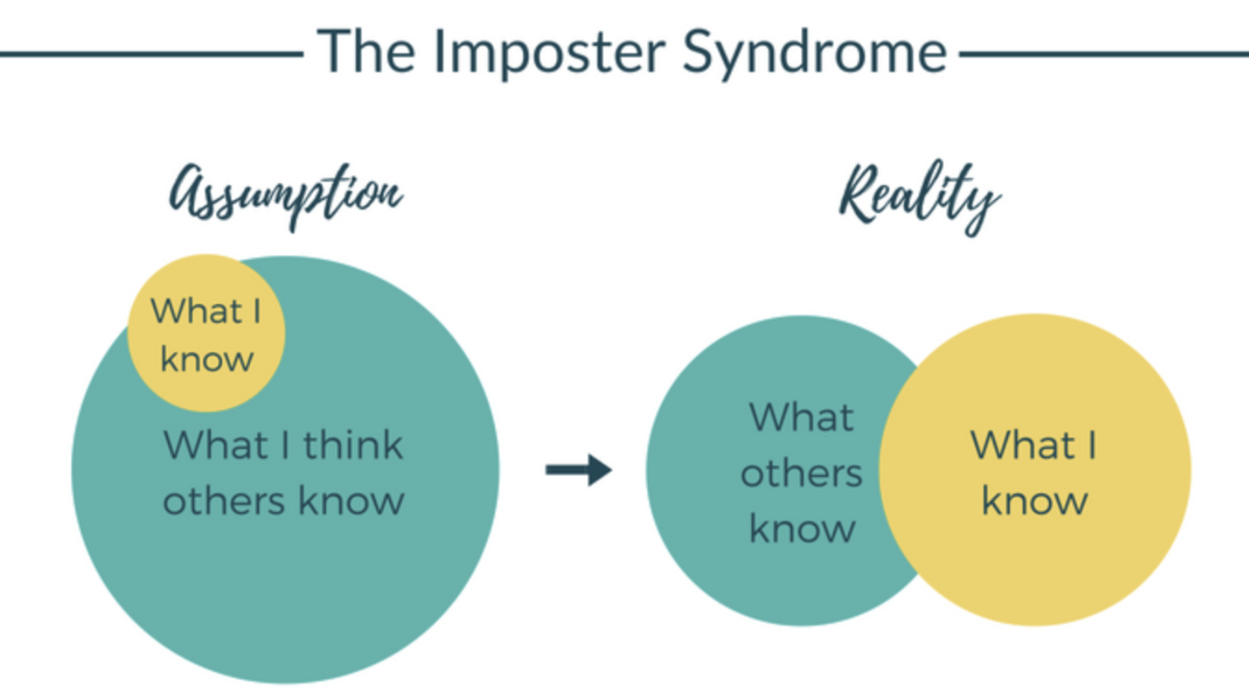
Imposter Syndrome
“Imposter syndrome is a psychological term referring to a pattern of behavior where people doubt their accomplishments and have a persistent, often internalised fear of being exposed as a fraud.”
It’s too easy to compare yourself to others.

Slide 3
Take charge of your imposter syndrome
Get comfortable with being uncomfortable - use it to fuel your growth, not your self-doubt. Adopt the growth mindset
There’s always more to learn! There will always be a more experienced developer next to you - that’s a good thing - you don’t want to be the smartest person in every room!
Feedback is a gift - seek it from your manager and your peers
Keep track of your accomplishments - reflect on your success
Figure out how you learn the best - everyone has ways they prefer to learn - this will make you more productive
Share your imposter syndrome - everyone feels it, sharing it dampens it!
…..

Slide 4


Mike Cannon-Brookes, Co-Founder of software company Atlassian, is an Australian business success story.
In his TED Talk, he reveals how he constantly feels like an imposter, but how he’s learned to harness those feelings for his benefit.

Slide 5
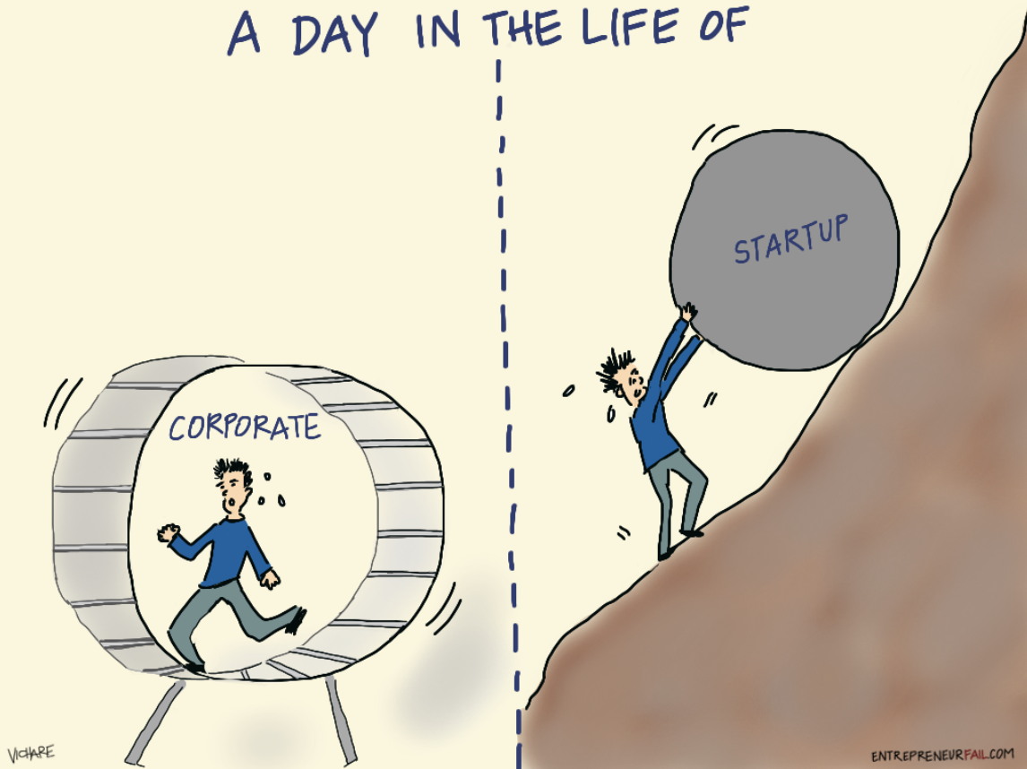
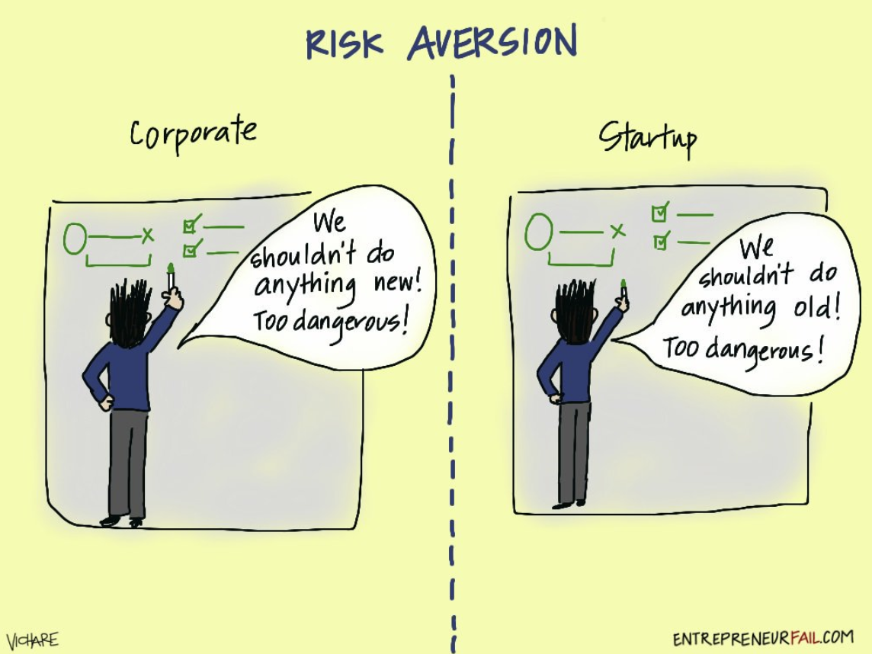
What type of company is best for you?
What’s life in technology companies like?
Question: What type of business / learning environment and culture appeals to you?

Slide 6
Start Up or SME vs Corporate Scale Organisations
Some Advantages of a large organisation
You Have More Obvious Structure
You're taking part in a machine that's been around for a long time and there’s typically an established process.
They’ve gone through the start up / scale up period of growth and risk.
Clearer definition on roles, departments & obvious pathways for promotions and possibly more stability.
The Benefits Packages Are Often Better
Larger companies, in general, are better at providing greater benefits schemes with Health Insurance, Share Schemes, Pension Plans, Training etc.
Scope to Change Jobs / Be Promoted
More options to change positions and explore a new area without leaving the company.
Find Your Tribe: What type of business / learning environment or culture appeals to you?

Slide 7
Start Up or SME vs Corporate Scale Organisations
Some Disadvantages of a large organisation
Changes Happen Slowly
Shaking things up at a big company can take a lot of time and potentially red tape and due process.
Releasing Code & Projects
Is it important to you that you work for a company that regularly releases code, or how often you work on new projects?
Do you want direct feedback from users
Do you want to work in an agile & iterative fast paced engineering culture?
Company Culture & Job Satisfaction
People buy what you do and more importantly why you do it.
People want to work with smart people, learn quickly, share ideas, collaborate toward goals, creativity and innovation.
Leaving your mark in a smaller company may be easier than in a corporate environment.

Slide 8
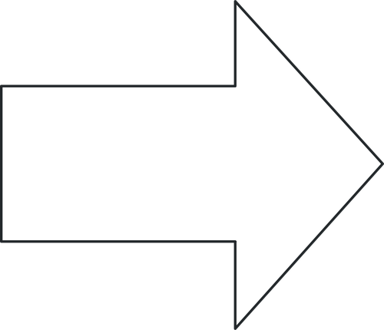
Start Up or SME vs Corporate Scale Organisations
Some Advantages of a small company:
Your Success is Visible
Unless you work near the top, accomplishing something significant at a large company may be less noticed. At a small company, however, great work can be seen by everyone.
Especially if you're starting out in a new career, working for a small company is a great way to establish your abilities and gain a reputation that can follow you for years.
You can learn a lot quickly in a start up or small business.
The Company Might Be More Agile & Fast Paced
You’ll likely work more closely with the business owners / leadership team.
What may take days or weeks of submission and approval processes at a big company may be quicker in a smaller business.
Your Responsibilities May be More Varied
In a larger company, you may be able to switch to a different job and exercise a different skill set without leaving your company. BUT in a smaller company, you may be required to learn and use a different skill set without leaving your desk - wear different hats, expand skills.

Slide 9
Start Up or SME vs Corporate Scale Organisations
Some Disadvantages of a small company or start up:
Ultimately, what company you go with will be largely determined by where you fit best.
Not everyone is best suited to all sizes of organisation.
Culture fit is a key factor for both you and the employer.
It's important to keep in mind not just where you'll get paid the most or have the best benefits, but where your particular personality and set of skills can be utilised most efficiently.
The Benefits Package Might Be Smaller
Smaller companies typically don't have as extensive a benefits package as larger companies do.
There May Be No Legal or HR Departments
mall companies often don't get around to setting up things like legal or Human Resources departments until they've been established for a while. This means there's no one in the company whose sole job is fielding complaints, arranging training, dealing with HR issues.

Slide 10
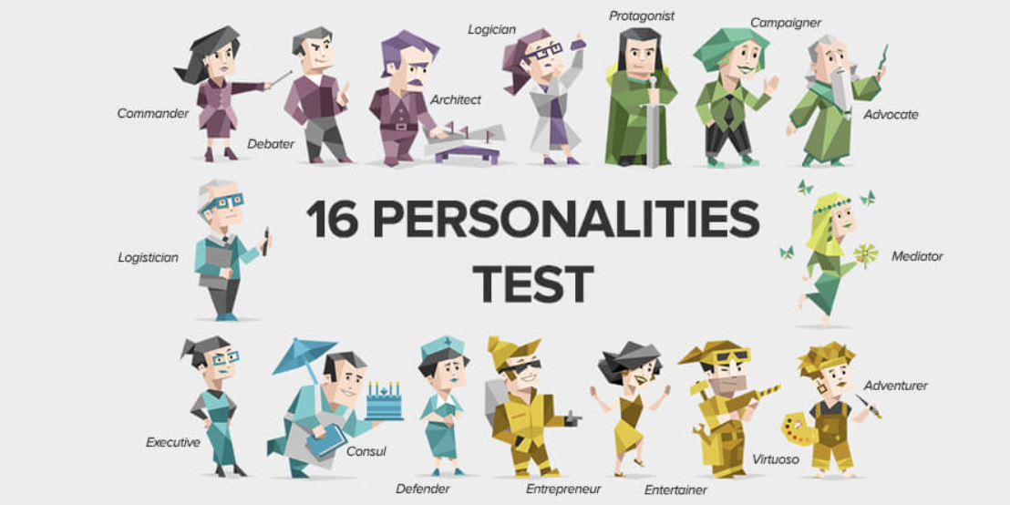
What type of company is best for you?
Learn the meaning of your personality type, your strengths and weaknesses, and find practical info on careers and relationships for your type.
Myers & Briggs proposed that there were 4 key dimensions that could be used to categorise people:
Introversion vs. Extraversion
Sensing vs. Intuition
Thinking vs. Feeling
Judging vs. Perceiving
Example:
Judgers appreciate structure and order; they like things planned, and dislike last-minute changes
Perceivers appreciate flexibility and spontaneity; they like to leave things open so they can change their minds
www.16personalities.com/
Myers Briggs 16 Personalities Test

Slide 11
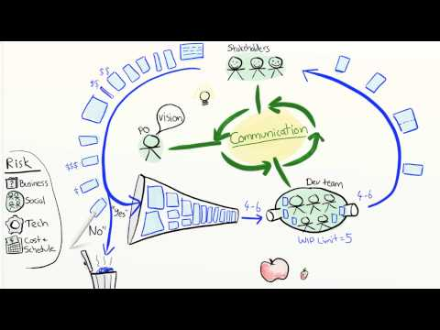
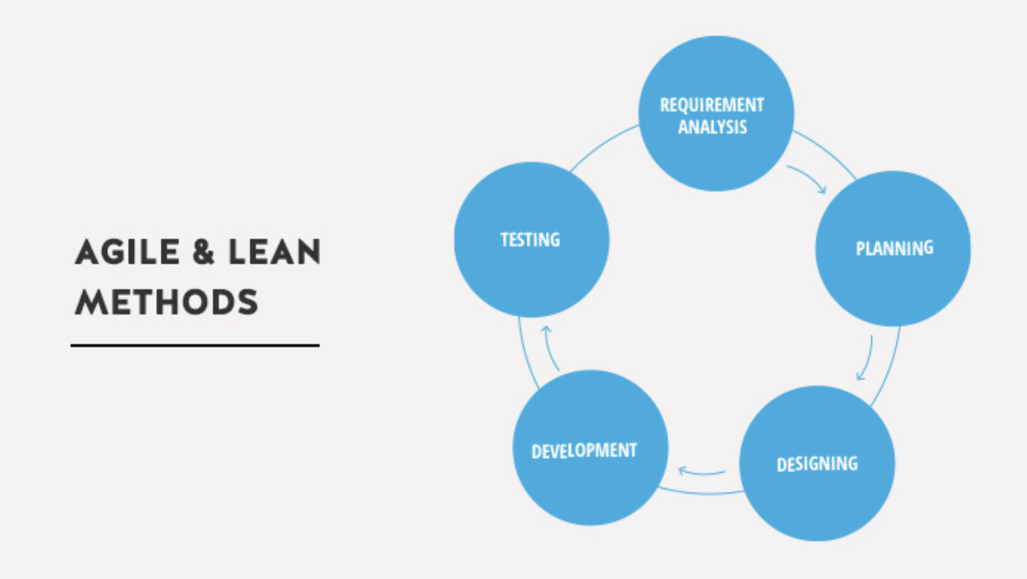
Agile Product Ownership in a Nutshell
Henrik Kniberg, Lean and Agile Coach

Slide 12
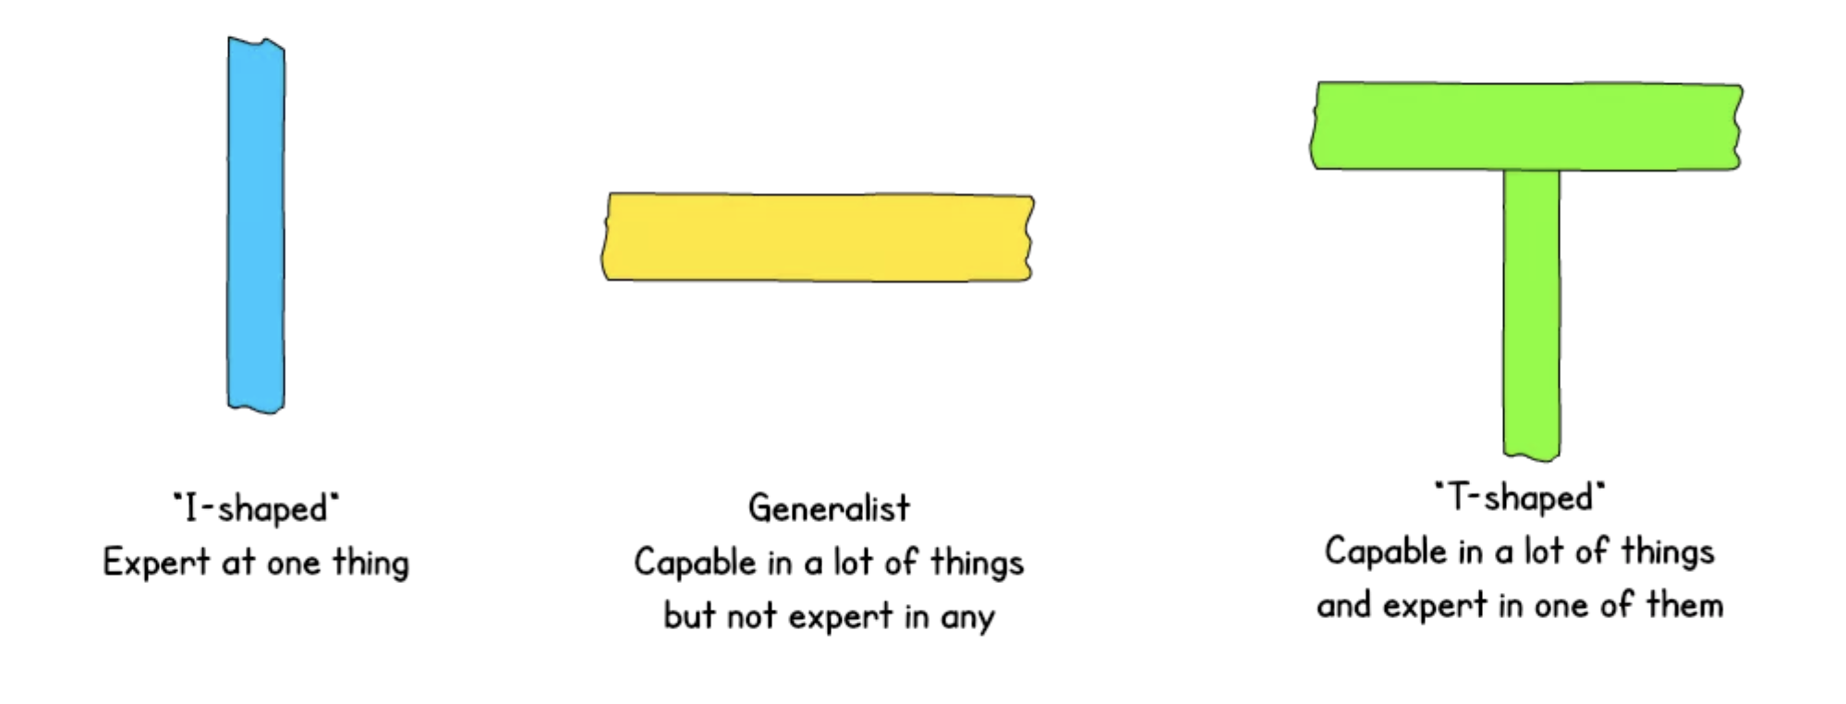
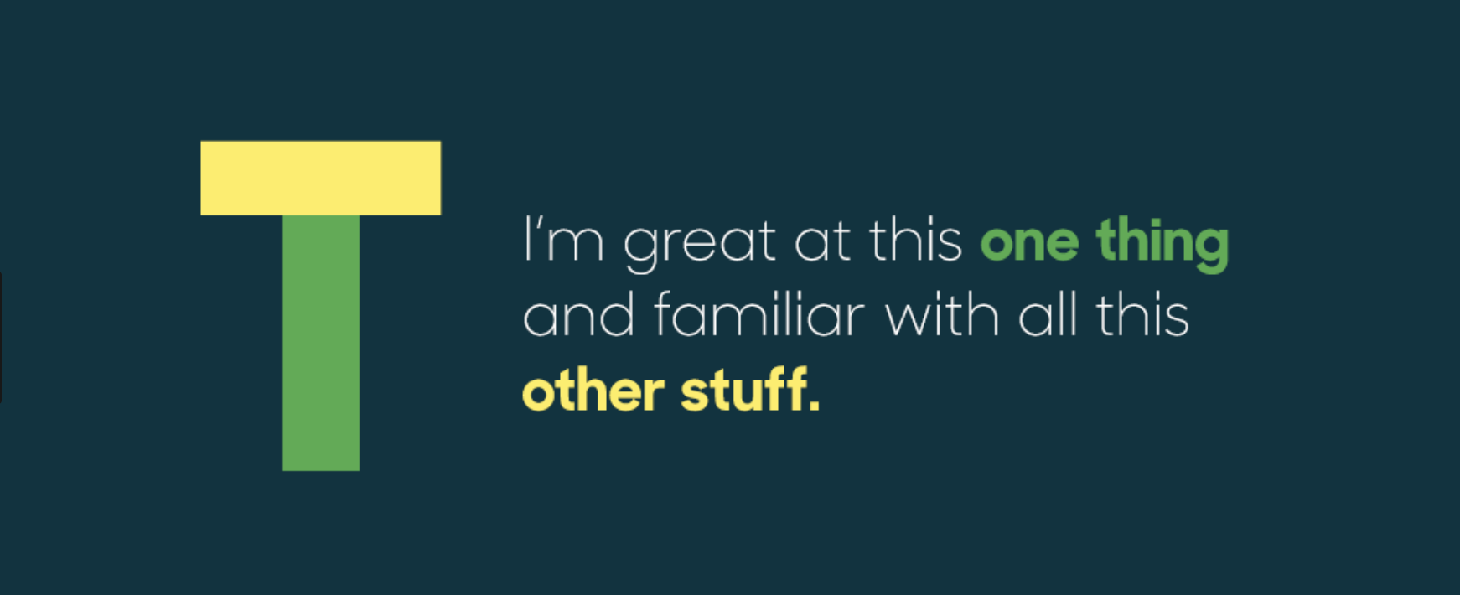
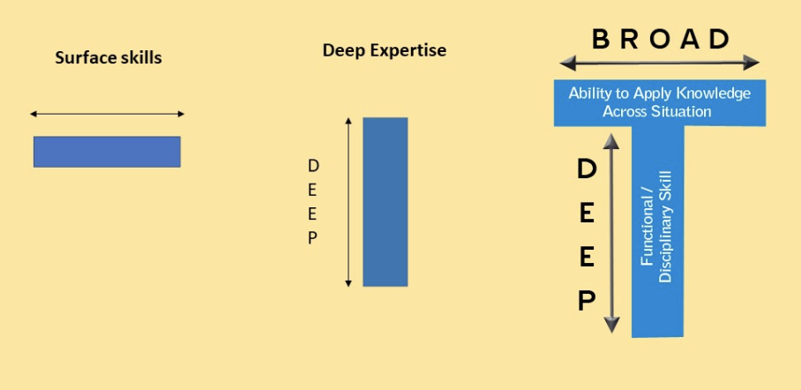
T Shaped People & Productive Teams
Which one are you just now?
Which one do you want to be?

Slide 13
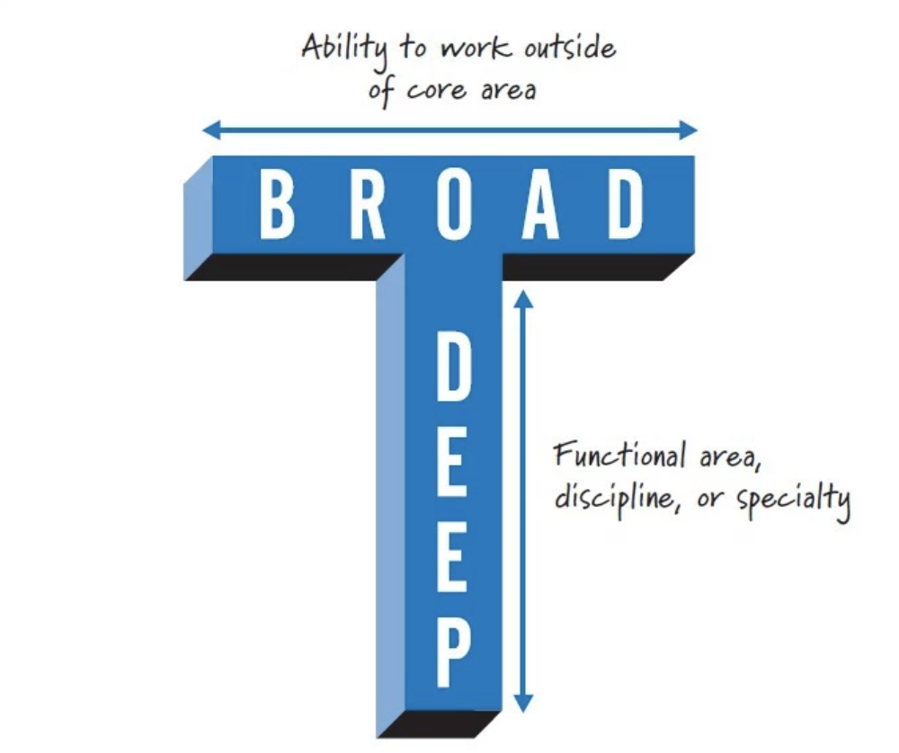
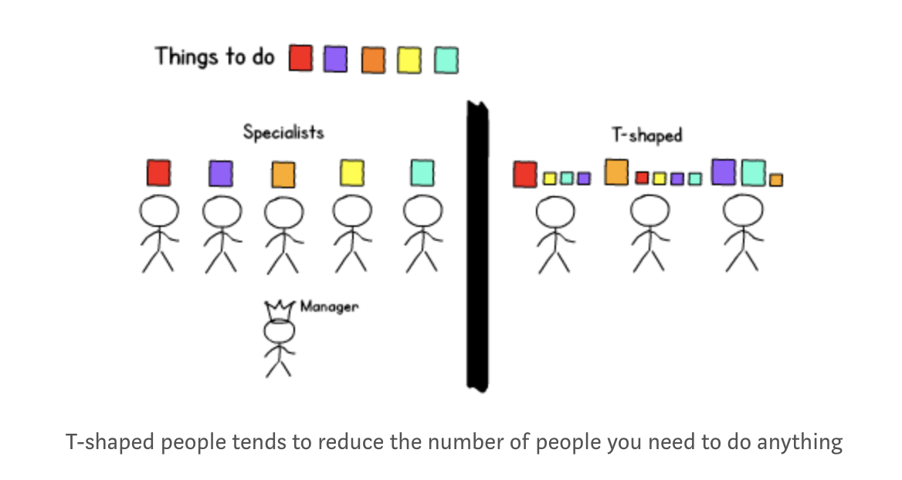
T-Shaped People Make Productive Teams
T-shaped people adapt to varying demands
Product delivery teams get asked to do a lot of different things, each of which require different skill sets

Slide 14
Benefits of T-shaped people in a business
T-shaped people deal with a core role and focus in their work, but also have the ability to branch out into other areas, supporting the business in a wider sense
They have hard and soft skills. Hard skills, such as programming or design are the desirable core traits employers look for; the softer skills such as critical thinking, planning, teamwork, problem solving and networking make up the whole package
They are flexible and adapt, communicate and collaborate better across a business and offer wider support
T-shaped people share experience and skills with others. They can encourage others to learn new skills too which leads to a stronger team that develops at a greater rate

Slide 15

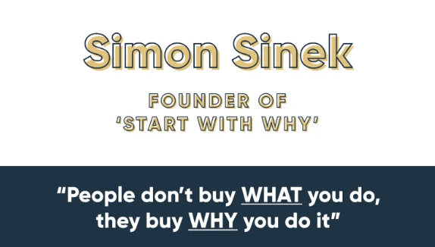
Your Why

Slide 16
What’s Important To You & Why?
Your WHY - Between now and meeting employers for networking & interviews it’s important to understand and be able to speak about:
the things that best describe you, your motivations & technical interests
your reasons behind your career change
how you can add value to their business / team
How do these fit into the key 5 things you want from an employer and your tech career?

Slide 17
YOUR EMPLOYERS OF CHOICE
DOING THE RESEARCH
Social media; Twitter, Facebook, Blogs (e.g. Medium)
LinkedIn (Careers/Jobs tab - follow those you’re interested in)
News search
CodeClan has a network ∴ you have a network!
Your connections / CodeClan Alumni
Have they hired CodeClan grads?
Do they host meetups, info sessions or hack days?
Previous CodeClan grad hiring
Who did they hire? What was their experience? What roles?
Website / app
Glassdoor (reviews and jobs)
Get to know their industry and competitors
Careers Team (Lorraine, Graeme, Fiona) and the wider CodeClan team
…..

Slide 18
Other things worth researching
company values (often guide interviews)
company milestones/achievements
staff / founders
management team, who are their leaders?
size, profits, impact
successes, news stories
how they’re making an impact in their own industry; are they market leading or paving the way?
what’s the appeal? What are they doing well at?
who are their users/customers?
who are their local/global competitors?
hiring process
company benefits
learning & development opportunities
career path opportunities
company culture
tech stack / tech culture
tech events, meetups & hiring opportunities

Slide 19
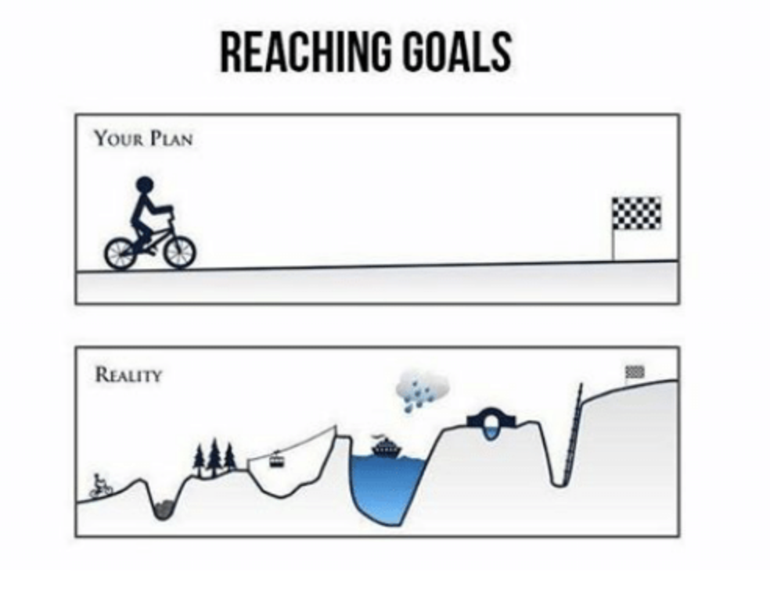
The Path To Success (and Job 1 after CodeClan)

Slide 20
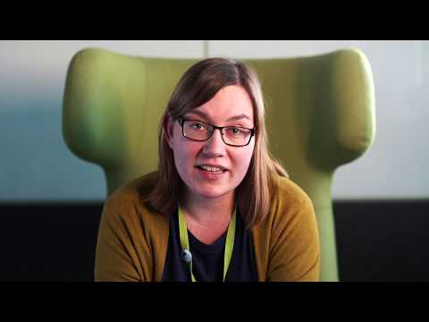
The Path To Success
Meet Ewa Software Developer & CodeClan Graduate
Cohort E20

Slide 21

www.codeclan.com

